Slide 1
Personality and Values

Slide 2
Personality
The ways individuals reacts to and interact with others
Enduring characteristics that describe an individual’s behavior

Slide 3
Personality Determinants
Gene vs. Environment
50% & 50%

Slide 4
Myers-Briggs Type Indicator (MBTI)
One of the most widely used
Individuals are classified as:
Extroverted vs. Introverted
Sensing vs. Intuitive
Thinking vs. Feeling
Judging vs. Perceiving
Problem?

Slide 5
Big 5
Five basic dimensions that include most of the significant variation in human personality

Slide 6
Big 5
Openness to experience - Interest in newness
Conscientiousness - Reliability
Extraversion - comfort level in relationship with others
Agreeableness - comply with others
Neuroticism (emotional stability) - Ability to tolerate stress

Slide 7
Linking Personality to the Workplace
Person-Job Fit Theory
Fit between personality type and occupational environment determines satisfaction and turnover.
Holland’s Hexagon

Slide 8
Linking Personality to the Workplace
Holland’s Hexagon
Realistic
Investigative
Artistic
Social
Enterprising
Conventional

Slide 9
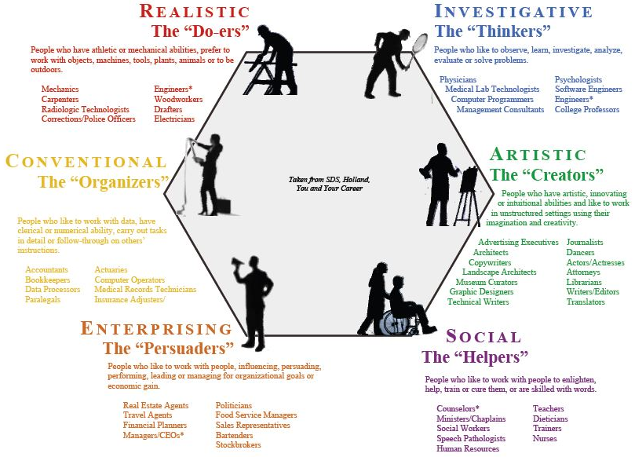

Slide 10
Other Personality Traits
Core Self-Evaluation
like own capability, competence, and worth
Self-Monitoring
Adjusting ability to different situations
Sensitivity to how others see them
Proactive Personality
Identify opportunities, show initiatives, and take actions

Slide 11
Dark Triad
Machiavellianism
ends can justify means; “if it works, use it”
pragmatic, emotional distance, focus on gaining power
Narcissism
Arrogant; require excessive admiration
Charismatic, emerge as leaders, psychological health
Psychopathy
Lack of concern for others, guilt or remorse when actions cause harm

Slide 12
Values
Values: basic convictions about what is right, good, or desirable.
Value system: ranking
Stable
Why important?

Slide 13
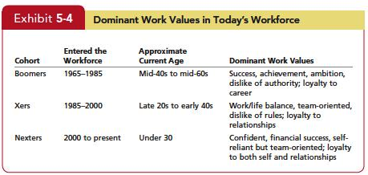
Values
Generational Values

Slide 14
Values
Generation Values
Limitations

Slide 15
Linking Personality and Values to the Workplace
Person-Organization Fit
Matching individual personalities or values to organization
Job satisfaction, commitment, low turnover
Organizational Change

Slide 16
International (Cultural) Values
Hofstede’s Study
116,000 IBM employees in 40 countries
Late 1970s
Different on five dimensions of value

Slide 17
International (Cultural) Values
Power Distance
Individualism/Collectivism
Masculinity/femininity
Uncertainty Avoidance
Long-term/Short-term orientation

Slide 18
International (Cultural) Values
Enormously influential on OB
Limitation

